Slide 1

The Living Sector
__
…Background
….Trends
…Opportunities

Slide 2
Key Take aways:
  Traditional residential sector has contributed to accelerated growth in the Living Sector.
  The living sector continues to consolidate but at different paces.
  The living sector now provides an attractive alternative to investors and competes against other uses.
  Opportunities still exist, both within established markets and emerging ones

Slide 3
The Residential Market: What’s Happening?

Slide 4


Portuguese population is steadily aging
A growing and ageing population
Demographics
Portuguese population estimates and projections
[Million people]
Portuguese population pyramid
[Thousand people]
1950
2024
Age
100
10,5
90
10,4
80
The Portuguese demographic prospects for the following 25 years show the following:
Mild population decline from the current estimated value of 10.4 Million, to a 9.8 Million people figure by 2050;
General ageing of the population, continuing the general trend of the previous 70 years.
Since 1971 population has grown from 8.6m to 10.4m (17%)
70
9,3
60
9,1
50
40
30
20
→
Projection
10
Sources: UNDP

Slide 5
Affordability is definitely decreasing
A decrease in affordability
Affordability
Average house price
[Thousand EUR]
Average salaries
[Thousand EUR/year; Gross]
Price to Income ratio
[Years]
Confidencial Imobiliário ⁽¹⁾
Confidencial Imobiliário ⁽²⁾
OECD
INE
OECD
There is a general consensus between different data sources that the house pricing is going up and the affordability is decreasing. Divergences exist, however, regarding the exact amount.
In 2012, it took anywhere from 5 to 6 years of average salaries to buy the average home. That number has been increasing steadily in the last decade until the current value of from 7 to 9 years of salary to buy a home.
INE
INE
OECD
Sources: Confidencial Imobiliário – (1) General Portuguese averagehouse price series; (2) Weighted average of NUT3 average house price; INE; OECD; World Bank

Slide 6
Restricted licensing and construction
A lack of supply
Lisbon
Norte
Centro
Alentejo
Algarve
The Fundamentals of Pricing
Decreased Licensing
[‘000 of licensed residential dwellings by licensing year]
‘05
‘07
‘09
‘11
‘13
‘15
‘17
‘19
‘21
‘23
Decreased Construction
[‘000 of built dwellings by construction end year]
The construction and licensing have been somewhat more restrictive from 2007 onwards.
This however contrasts with the increased number of transactions experienced especially from 2012 onwards.
The rising number of transactions under a framework of reduced licensing and constructions had an effect on the prices of the residences.
Increased Transactions
[‘000 of residential transactions per year]
‘04
‘06
‘08
‘10
‘12
‘14
‘16
‘18
‘20
’22
Sources: INE

Slide 7
Less houses being built
Growing population leading to increased demand
Influx of foreign buyers also putting pressure on prices
Resulting in less affordability in traditional residential sector
Contributing to the emerging living sector

Slide 8
The living sector and it’s evolution…..

Slide 9



Emerging and Consolidating
The Living Sector
PBSA à Flex/Co-Living à The family years à Active ageing concepts à Elderly Care Homes

Slide 10
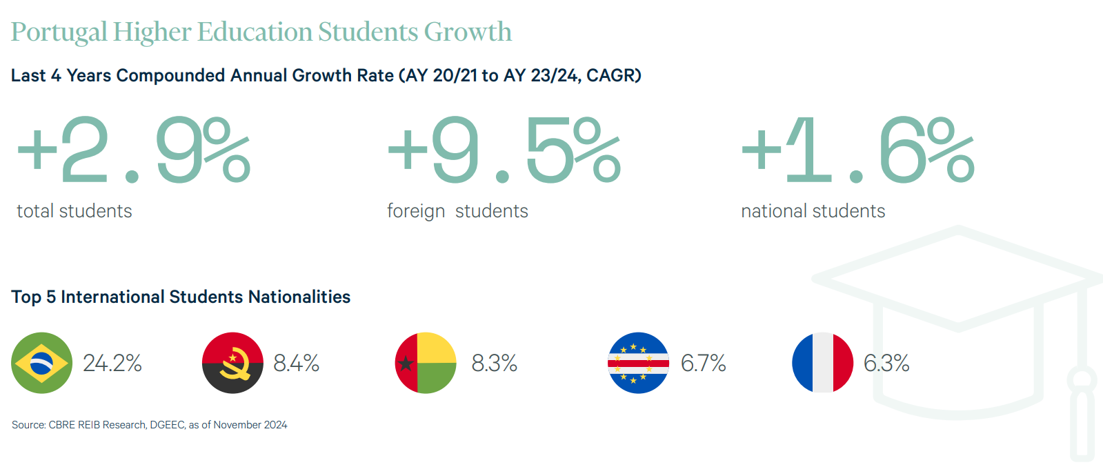
LIVING SECTOR
PBSA
First PBSA was Colegiate’s conversion of a former Post Office Building in Lisbon.
2017 to present day
Now evolved into a well-established sector with strong international interest.
Sector which now includes large international operators and also national players.
Lisbon and Porto remain undersupplied
Porto: c.90,000 students
Lisbon: c. 147,000 students

Slide 11
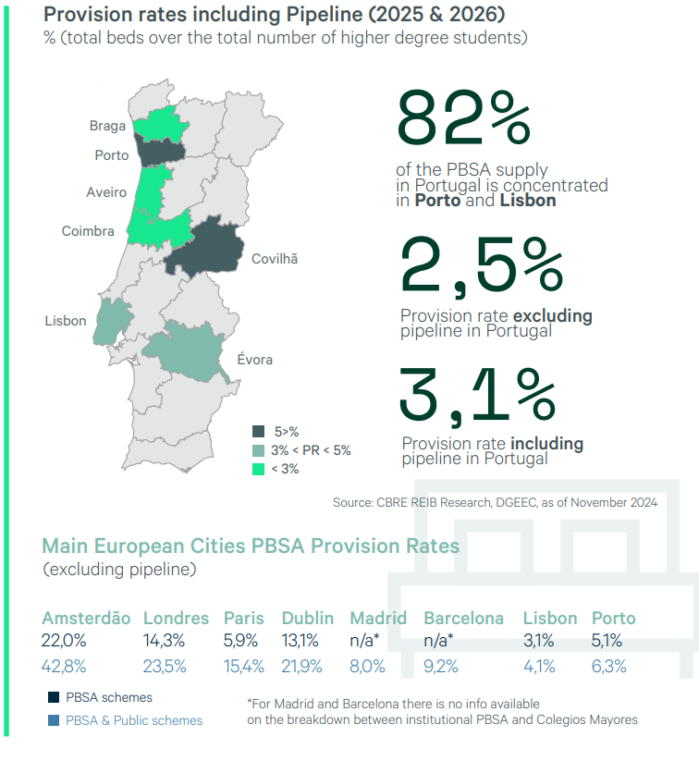
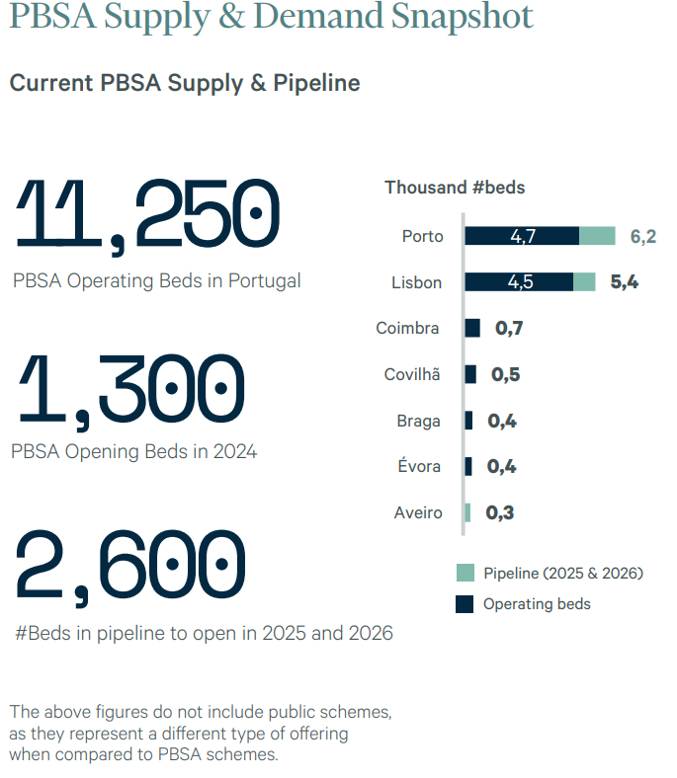
LIVING SECTOR
PBSA

Slide 12
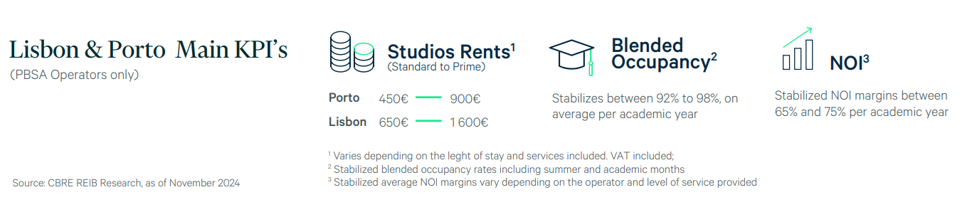

LIVING SECTOR
PBSA

Slide 13
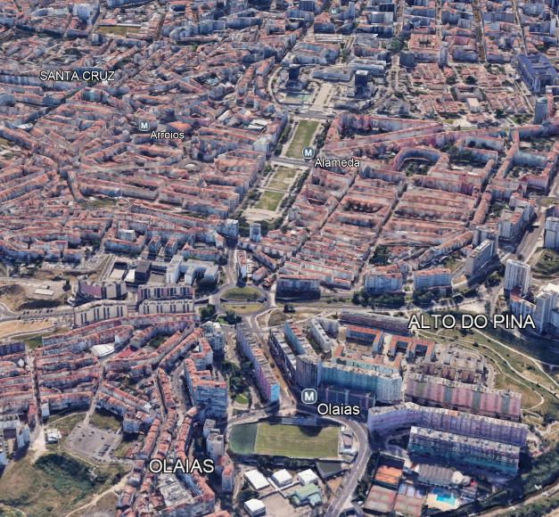
LIVING SECTOR
PBSA
Case Study: PBSA/Flex v Residential v Offices
New build residential: c. €6,000/m2
Office building: c. €4,000/m2
PBSA/Flex: c. €5,000/m2
Technical Uni. 10,000 students
5 min. in metro to Olaias or 15 min. walk
Olaias neighbourhood

Slide 14
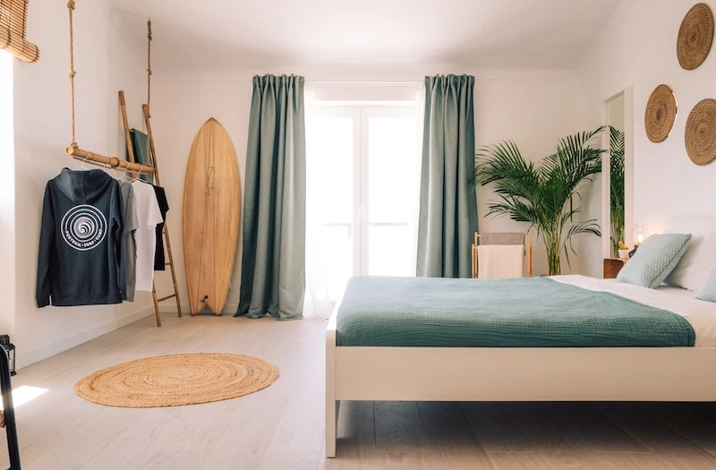
LIVING SECTOR
Flex and Co-Living
Already well established in Spain
In it’s infancy in Portugal.
Sector with huge potential due to a combination of factors:
Barriers of access to home ownership
Lack of residential supply
Strong international and local demand
Gradual consolidation of the sector
Nomadico, Ericeira

Slide 15
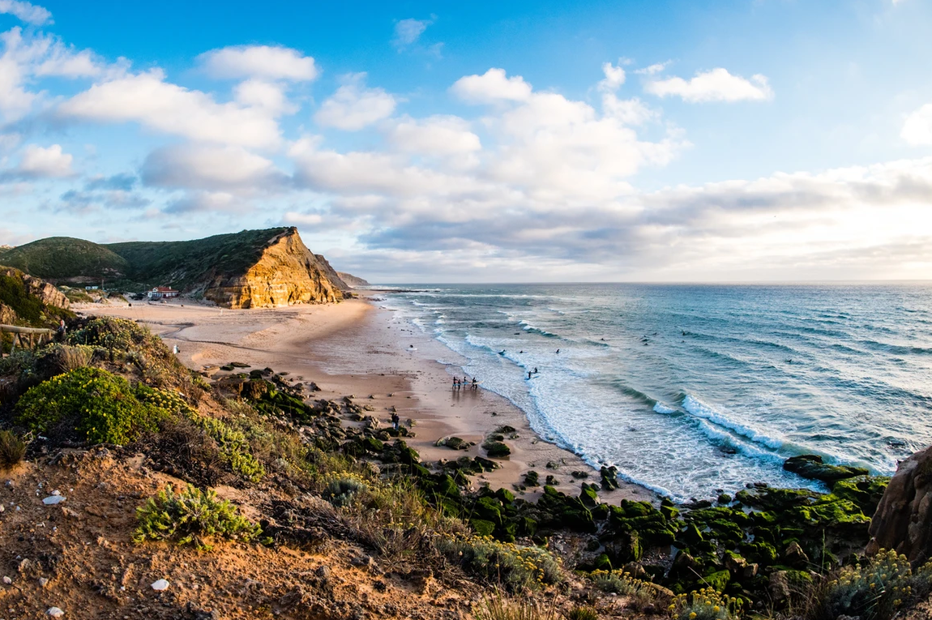
LIVING SECTOR
Case Study: ABOUT ERICEIRA
Flex and Co-Living
Less than 45 minutes from Lisbon
Surfing Paradise: Ericeira is renowned as one of the best surfing destinations in Europe. It was designated as a World Surfing Reserve in 2011, making it the first and only one in Europe.
Some of the best seafood in Portugal
Rugged coastline with sweeping sand beaches and imposing sea cliffs
Laid back vibe mixing traditional Portuguese fishing town with a moder laid back vibe.

Slide 16
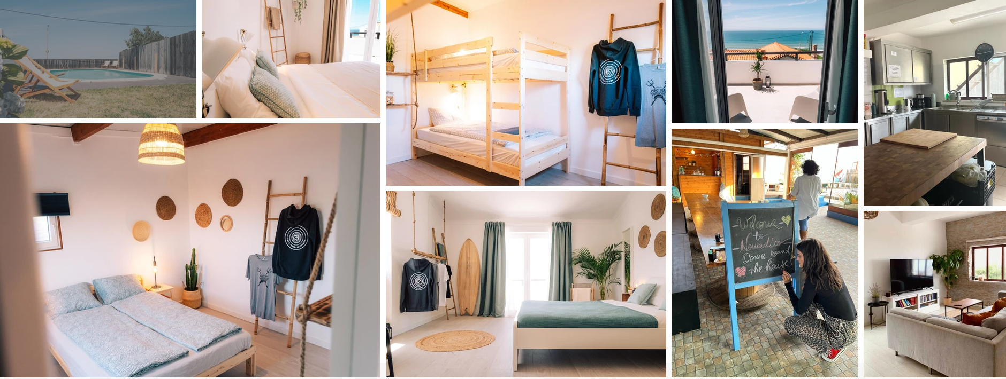
LIVING SECTOR
Case Study: ABOUT ERICEIRA
Flex and Co-Living
Local operators including locally run Nomadico shown in the photo.
They operate and 11 bed scheme.
Facilties include:
Weekly Cleaning, co-working, community manager, workspaces in rooms, skate ramp and community events.
Prices:
€600/month for shared room
€800/month for single en-suite
€1,000/month for premium en-suite
Nomadico, Ericeira

Slide 17
The future…..

Slide 18
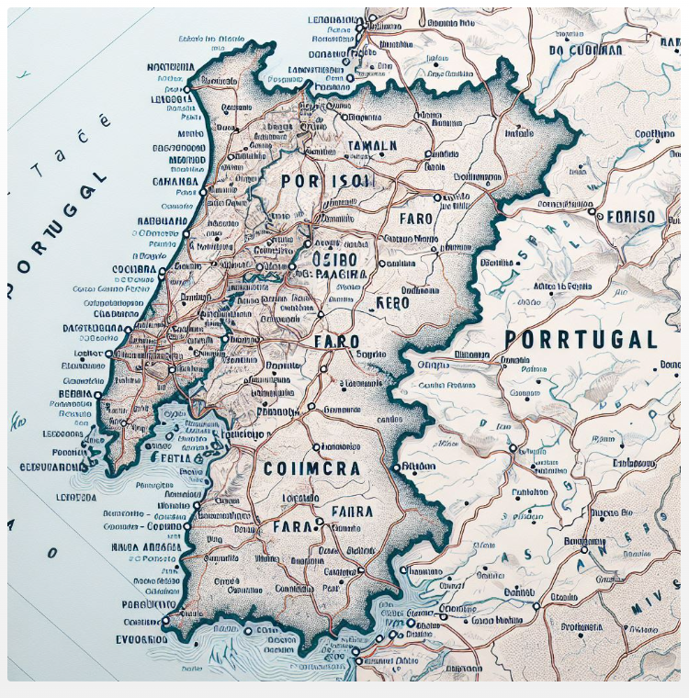
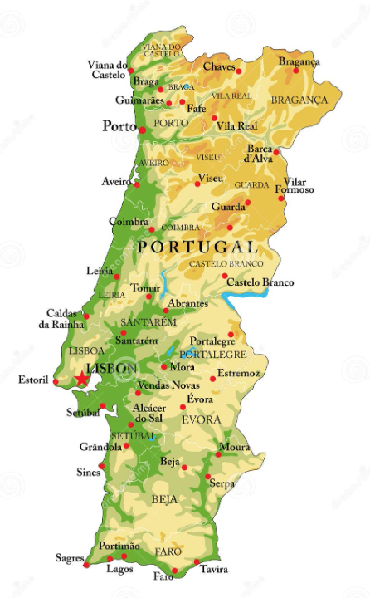
THE FUTURE
NEW LOCATIONS

Slide 19

THE FUTURE
NEW concepts

Slide 20
The end

